Slide 1
Indian Railways Maintenance Analysis
Data-Driven Insights for Predictive Maintenance

Slide 2
Introduction
Indian Railways operates one of the world's most extensive networks. To ensure safety and operational efficiency, maintenance of locomotives and coaches is critical. This project explores data collected from Indian Railways maintenance logs to understand patterns, predict future requirements, and improve planning using data visualization and machine learning.

Slide 3
Our Mission
Our goal is to use machine learning and visual analytics to:
- Identify trains likely to need maintenance soon
- Understand operational patterns that lead to failure
- Assist Indian Railways in optimizing maintenance schedules
- Reduce unplanned downtime and improve safety

Slide 4
Dataset Overview
We collected a dataset simulating real-world Indian Railways maintenance records. The dataset contains 1 million entries and 10 columns, including:
- Train_ID: 6-digit unique ID
- Loco_Type & Coach_Type
- Mileage & Operating_Hours
- Failure_Incidents
- Last and Next Maintenance Dates
- Region and Maintenance Type

Slide 5
Data Collection Methodology
The dataset was generated using Python scripts to reflect real-world behavior:
- Train IDs and values were collected using uniform and Gaussian distributions
- Date intervals reflect common Indian Railways maintenance cycles
- Failure and mileage metrics correlate to model real wear and tear

Slide 6
Data Preprocessing Steps
Preprocessing involved
- Converting date columns to datetime objects
- Calculating 'Days Until Next Maintenance'
- Removing inconsistencies and handling missing values
- Feature engineering to improve model performance

Slide 7
Preparing for Predictive Maintenance
Date Conversion: Converted string-based date fields like Last_Maintenance_Date and Next_Maintenance_Date into datetime format.This allowed us to compute intervals and durations.
Feature Engineering: Created a new feature: Days_Until_Next_Maintenance = Difference between next and last maintenance dates.This became our target variable for prediction.
Handling Missing Values:Detected and removed or imputed rows with missing or inconsistent data (e.g., null failure counts or negative mileage).Ensured model is trained on reliable information only.
Outcome: A clean, structured dataset with meaningful features that power accurate and robust machine learning predictions.

Slide 8
EDA
EDA (Exploratory Data Analysis)Maintenance happens mostly every 60–120 days.
Higher mileage = less time left for next maintenance.
Diesel trains need maintenance less often.
More mileage and hours don’t always mean more failures—maintenance is working!
Some train types fail more often—they need extra attention.
Region-based analysis helps plan where to send resources.

Slide 9
Modeling – Predicting Train Maintenance Needs
We used the Random Forest Regressor algorithm for predicting upcoming maintenance needs.
Features used:
- Mileage, Operating Hours, Failure Incidents
Target:
- Days Until Next Maintenance
The model helps identify when a train should ideally undergo maintenance.

Slide 10
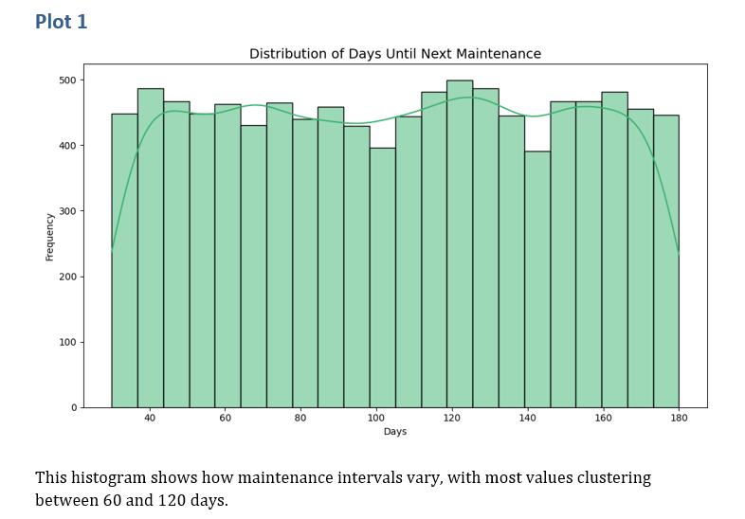
Distribution of Days Until Next Maintenance
This distribution plot shows how often maintenance occurs. Most records suggest a cycle between 60–120 days, helping prioritize short-term vs long-term planning.

Slide 11
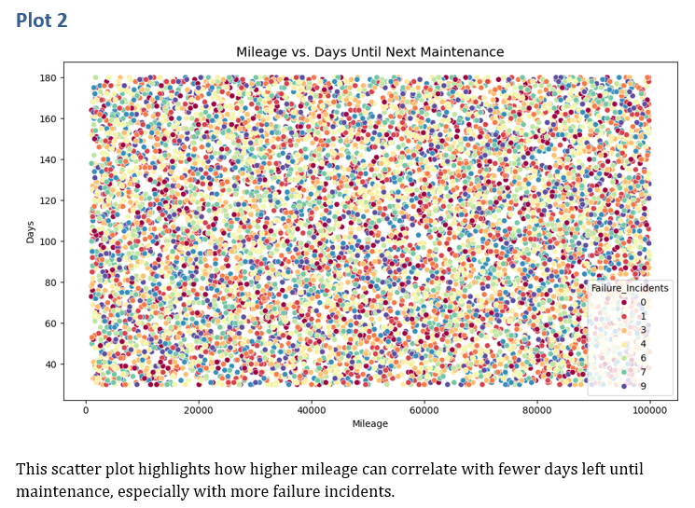
Mileage vs. Days Until Next Maintenance
Insight:
A negative correlation is visible: higher mileage tends to align with fewer days left until the next maintenance.
Implication:
Proactive maintenance may be triggered by mileage and failure patterns. Predictive maintenance strategies could be beneficial.

Slide 12
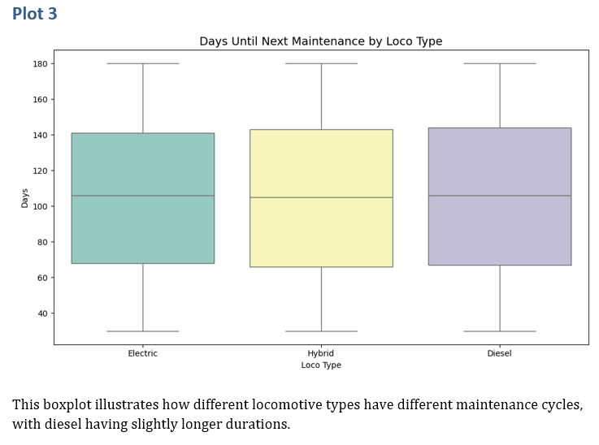
Days Until Next Maintenance by Loco Type
Insight:
Different locomotive types have varied maintenance cycles. Diesel locomotives generally show slightly longer intervals between maintenance compared to others.
Implication:
Maintenance strategies should be tailored to locomotive type, recognizing their operational and mechanical differences.

Slide 13
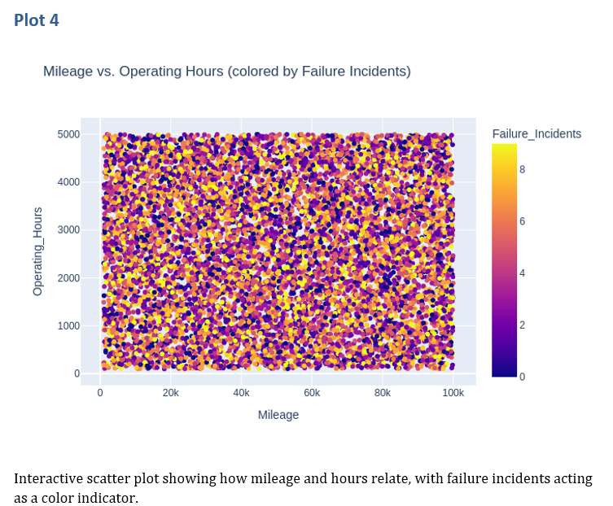
Mileage vs Operating Hours (Interactive)
Insight:
Mileage and operating hours have a strong linear relationship. Failure incidents are encoded by color, likely indicating higher risk at greater usage levels.
Implication:
High mileage and operating hours jointly signal elevated maintenance needs. Real-time visualization tools can assist in operational monitoring.

Slide 14
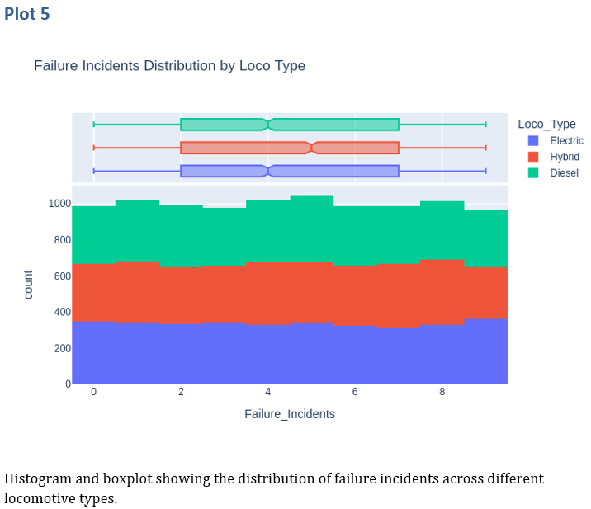
Failure Incidents by Loco Type
Insight:
Distributions reveal which locomotive types experience more frequent failures. Boxplots likely indicate variance and outliers—some types are more prone to failures.
Implication:
Identifying problematic locomotive types allows targeted upgrades, replacements, or revised maintenance plans.

Slide 15
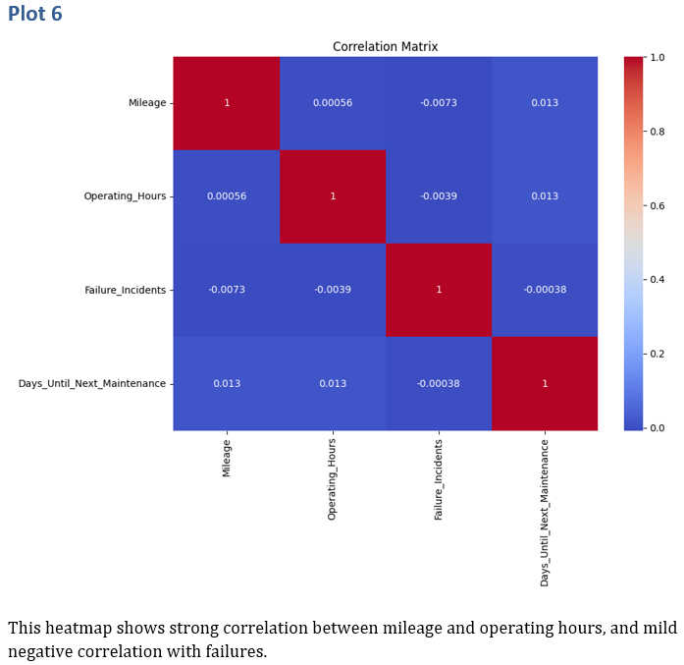
Correlation Matrix of Numerical Features
Insight:
Strong correlation between mileage and operating hours. Mild negative correlation with failures suggests that higher utilization doesn’t always result in more failures, possibly due to consistent maintenance.
Implication:
Regular maintenance seems effective in mitigating failure risks despite heavy usage.

Slide 16
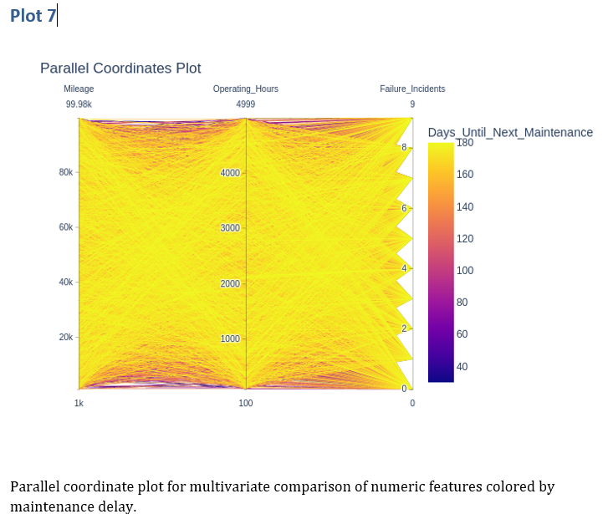
Parallel Coordinates Plot
Insight:
Multivariate comparison across numeric features such as mileage, hours, failures, and maintenance delay. Color-coded by maintenance delay, showing patterns across multiple dimensions.
Implication:
Useful for anomaly detection and understanding which factors lead to longer delays.

Slide 17
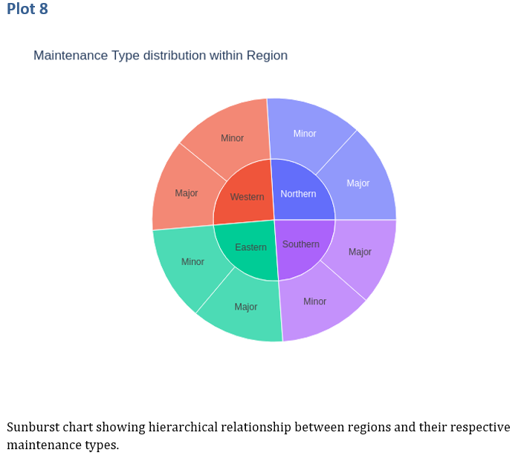
Maintenance Type within Regions
Insight:
Hierarchical breakdown of regions and their respective maintenance types.
Implication:
Enables strategic regional planning and resource deployment.

Slide 18
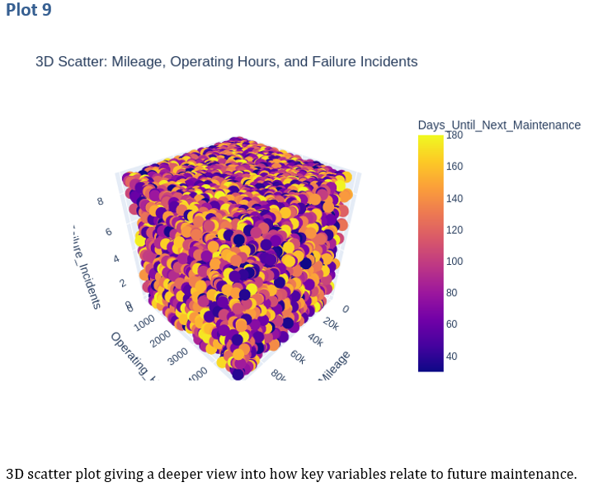
3D Scatter of Mileage, Hours & Failures
Insight:
Visualizes how combinations of factors (e.g., mileage, hours, failures) influence the predicted timing of future maintenance.
Implication:
Can serve as a foundation for machine learning models to forecast maintenance needs.

Slide 19
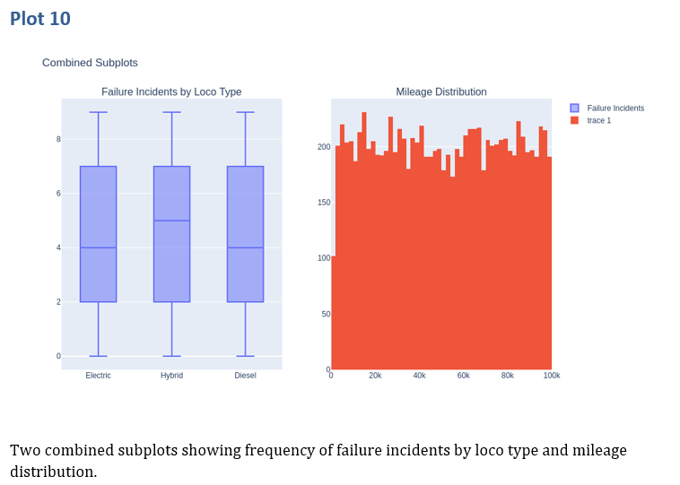
Combined View: Failures & Mileage
Insight:
The first subplot highlights which types are failure-prone. The second reveals mileage spread, possibly identifying overused or underused assets.
Implication:
Cross-referencing both subplots could inform decisions about redistributing locomotive workload.

Slide 20
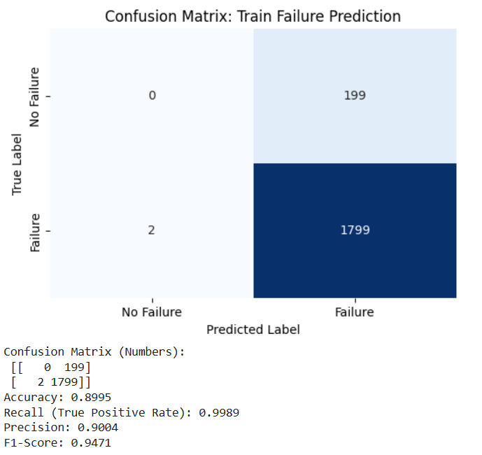
EVALUATION

Slide 21
Analytics & Prediction
With machine learning models and visual insights, we can:
- Predict which trains need maintenance in the near future
- Flag high-mileage, high-risk locomotives
- Assist in allocating regional maintenance efforts
- Reduce operational delays and increase rail safety

Slide 22
Conclusion
Predictive Maintenance Potential: Data clearly shows patterns that can be leveraged for predictive analytics, reducing unplanned downtime.
Asset Management: Locomotive types and their unique profiles necessitate individualized maintenance schedules.
Operational Efficiency: High mileage and long operating hours are not always correlated with failures, suggesting current maintenance protocols are effective.
Regional Planning: The sunburst chart supports regional strategy development, which is critical for a large network like Indian Railways.

Slide 23
THANK YOU
.

